Slide 1
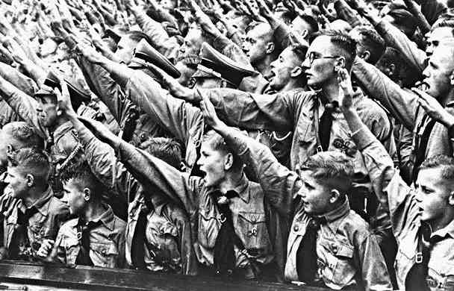
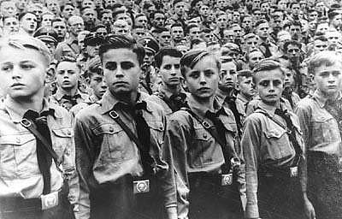
Changing Life In Germany 1933-39
The Hitler Youth
‘Those who have youth on their side control the future.’

Slide 2
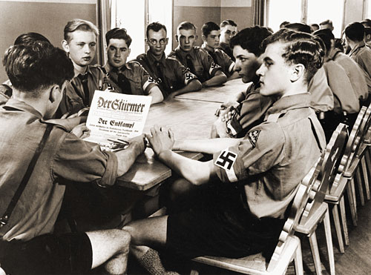
Historical Background
The Hitler Youth movement emphasized:
    activism, physical training, NAZI ideology, especially nationalism and racial concepts, and absolute obedience to Hitler and the NAZI Party
Hitler saw the Hitler Youth movement as a tool to hardening boys for their future role of soldiers.
    He wanted a generation of "victorious active, daring youth, immune to pain."

Slide 3
Historical Background
The Nazis seized power in 1933. Independent youth groups were absorbed into the Hitler Youth or abolished. There were programs for both boys and girls, but they were very different given Hitler's concept of the proper role of women.

Slide 4
How Youths were Organized
Boys
10 – 14 Years Old
Deutsches Jungvolk – DJ (Pimpfen)
German Young People (Cubs)
Girls
10 – 14 Years Old
Jungmadelbund – JM
League of Young Girls
Boys
14 - 18 Years Old
Hitler Jugend – HJ
Hitler Youth
Girls
14 - 18 Years Old
Bund Deutscher Madel – BDM
League of German Girls

Slide 5
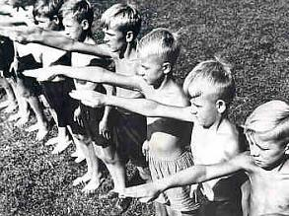
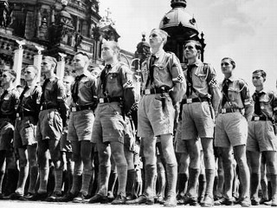
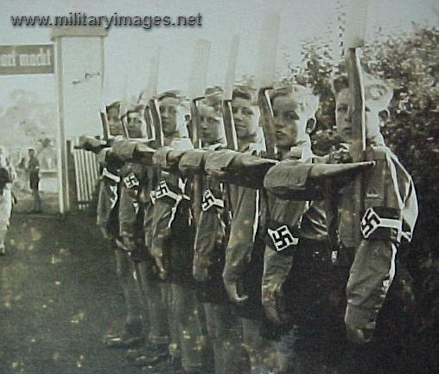
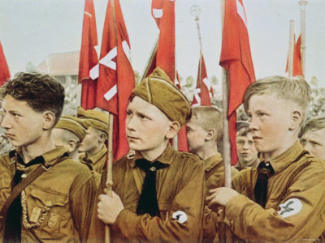
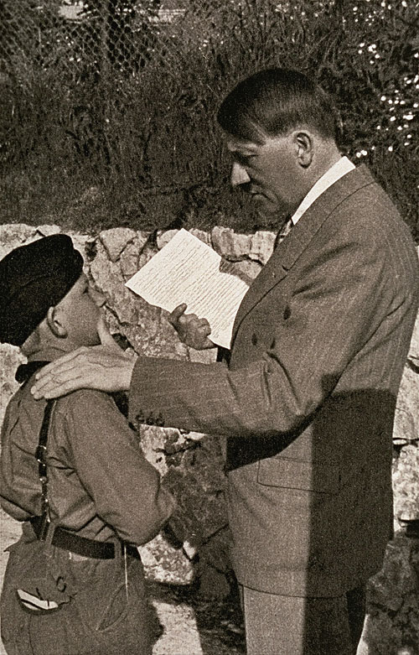
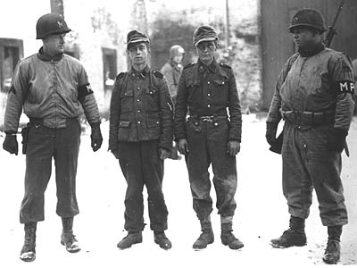
Youth becoming...

Slide 6
Hitler Youth
Rules
Members of the HJ must not be seen in uniform with girls
Members of the HJ must not buy things at Jewish shops
HJ members must ignore friends and parents while marching along as a HJ
After reading through these rules, how much control do you think that the HJ had over the lives of young people within Nazi Germany?
Rules taken from Nazi Power in Germany by Greg and Jean Thie, Hutchinson, 1989

Slide 7
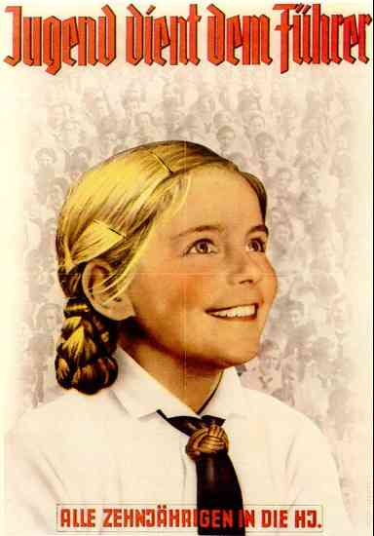
Propaganda
The Nazis used posters like this to
attract young people to join them.
The Nazis wanted all young people
to become loyal followers of Hitler.
So they started a youth movement:
the Hitlerjugend (HJ, or "Hitler Youth").
In 1933, 3.5 million young people
were members of the Hitler Youth.

Slide 8
You experienced outdoor activities such as hiking and camping
You had to swear an oath of allegiance to the Fuhrer
The abbreviation used for Hitler Youth is HJ
At 14 girls joined the League of German Girls - BDM
Hitler Youth
Facts
The aim of the HJ was to prepare boys for military service and to be strong future leaders of Germany
The Hitler Youth Law was passed in 1936 and stated that all youths should belong to the Hitler Youth.
By 1939 there were 7.3 million members of The Hitler Youth
Emphasis in the HJ and BDM was placed upon physical fitness, group activities and obedience to the Nazi Party
The aim of the BDM was to prepare girls for motherhood

Slide 9
WORDS, PROMISES, and ALLEGINACES from Members of Hitler’s Youth
“In the presence of this blood banner which represents the Fuhrer, I swear to devote all my energies and my strength to the saviour of our country, Adolf Hitler. I am willing and ready to give up my life for him, so help me God.”
An oath taken by 10 Year Olds when they entered the Deutsches Jungvolk
“I promise to do my duty in love and loyalty to the Fuhrer and our flag.”
The Pledge of Allegiance taken by all members of the Hitler Youth

Slide 10
Figures showing membership of the Hitler Youth
108,000
3.6 million
5.4 million
7.0 million
7.3 million
It may be worth noting that the total number of 10-18 year olds in Germany in 1939 was 8.9 million.

Slide 11
What do you think a Heim was and why do you think that the members of the Nazi Youth Groups liked it so much?
“We were very proud of our new Heim. It stood on one of the most beautiful spots in our part of the town, close to the park. The Hitler Youth, the Bund Deutscher Madel (League of German Maidens), the Jungmadel (Young Maidens), and the Jungvolk could all do their duty there simultaneously. Each unit had a business room and a large room for indoor duty. Wide windows and pale furniture made the rooms light. Books stood on the wall shelves in easy reach of everybody. Parlour games lay in the open cupboard; table-tennis tops were propped in the corner. We had a fully equipped workshop in the cellar, as well as showers. A caretaker couple looked after the cleaning and the heating.”
Taken from ‘I Was There’ by Hans Peter Richter (Puffin Books, 1987)

Slide 12
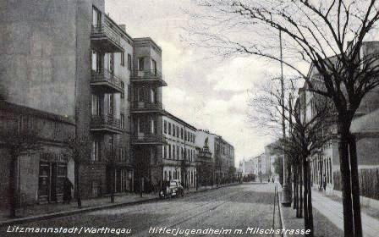
HEIM- Hitler's Youth Home

Slide 13
Many young people enjoyed the excitement of the HJ – camping, hiking, weapons training…
Many young people liked the feeling of importance – the uniform, the respect, the adoration…
How did young people
within Germany react
to the HJ?
Lots of youths resented the fact that their old clubs and youth groups were banned
Many youths disliked the strict regimentation – being told what to do and when to do it
Alternative youth groups sprang up across Germany –
e.g. The Edelweiss Pirates, The Navajos Gang, The Kittelbach Pirates…
Lots of youths wanted to listen to Jazz and try out new fashions and hair styles. All of these activities were banned in The Hitler Youth

Slide 14


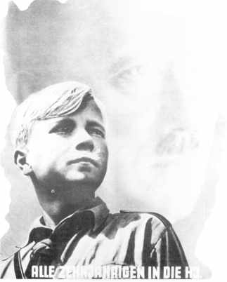
What I can see
Hitler in the background
Key Questions
Who is this poster aimed at?
Why was this poster produced?
Young HJ boy.
Aryan in appearance, serious, looking ahead
(in awe?)
Military/ Smart Uniform
“Youth Serves the Führer”
All 10-year-olds into the Hitler Youth."
Caption in Bold

Slide 15
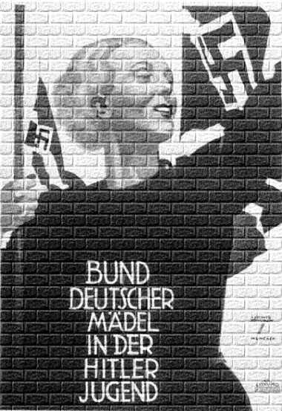
What I can see
Nazi Party Flag
Key Questions
Smiling, happy
Who is this poster aimed at?
Why was this poster produced?
What makes it so effective?
Aryan and healthy in appearance
Flag bearer
Caption/
message in bold

Slide 16
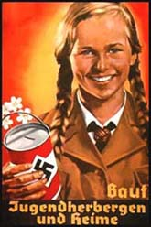
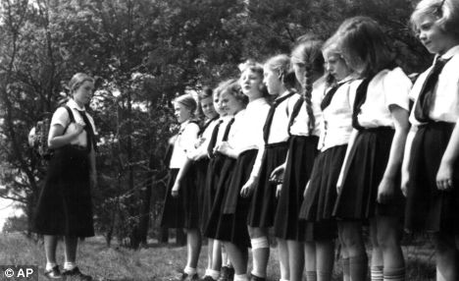
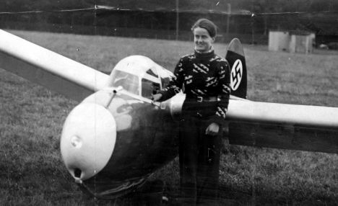
Hitler Youth: League of German Girls

Slide 17
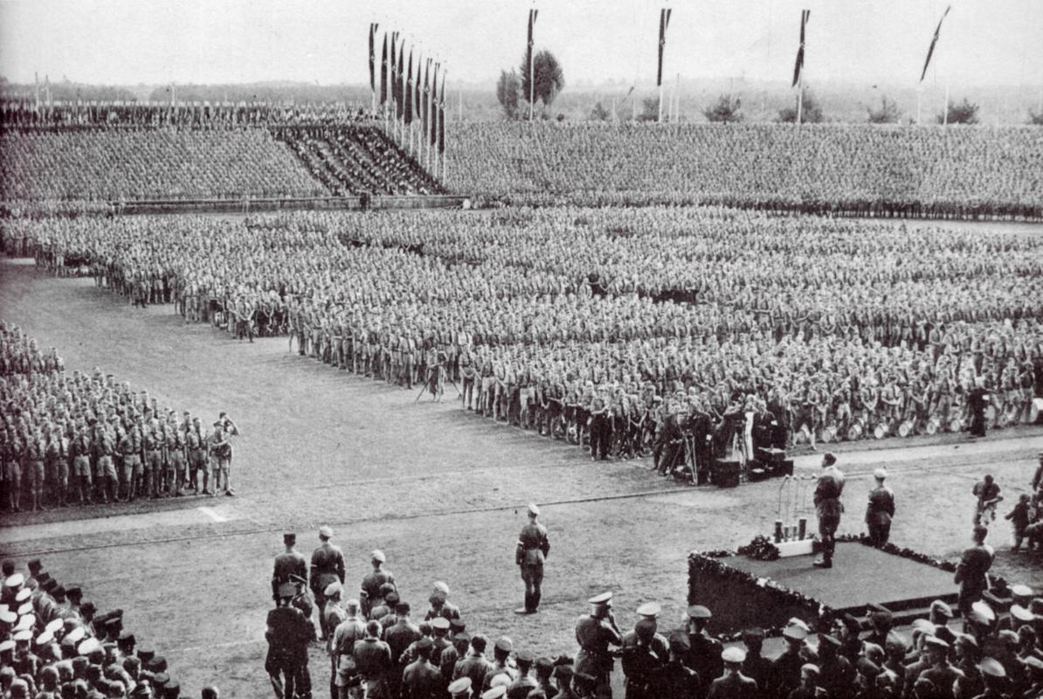
Adolf Hitler addresses Hitlerjugend (Hitler Youth) at a Nuremberg Nazi Party Day rally

